Slide 1

Web and Mobile Technologies
ASSIGNMENT - CA 1

Slide 2
Technologies used
HTML5
CSS3
JAVASCRIPT
JQUERY
JSON
TOOLS USED
VISUAL STUDIO CODE
XAMPP

Slide 3
Problem statement
DEVELOP A RESPONSIVE WEB APPLICATION, OPTIMISED FOR MOBILE, TABLETS AND DESKTOP DEVICES
FEATURES
JOB SEARCHING WEBSITE
LIST CURRENT VACCANCIES
SUPPORTS JOBS FILTERING
SUPPORT APPLICATION OF SELECTED JOBS
SUPPORT USER DATA INPUT FOR JOB APPLICATION
SUPPORT USER DATA VALIDATION

Slide 4
APPROCH
PICKED REFERENCE SITE – INDEED.IE
PAGE LAYOUT CREATED WITH 3 MAIN HTML DIVS
NAV BAR
MAIN CONTENT
DYNAMIC DATA CREATED USING JAVASCRIPT/JQUERY
DYNAMICALLY POPULATE THIS DIV AS PER PAGE REQUIREMENT
FOOTER
JOBS DATA PARSED FROM JSON FILE USING JQUERY
FORMS DATA VALIDATIONS DONE USING JAVASCRIPT
USED W3SCHOOL FOR TECHNICAL REFERENCE
USED STACKOVERFLOW.COM FOR SOLVING ISSUES

Slide 5

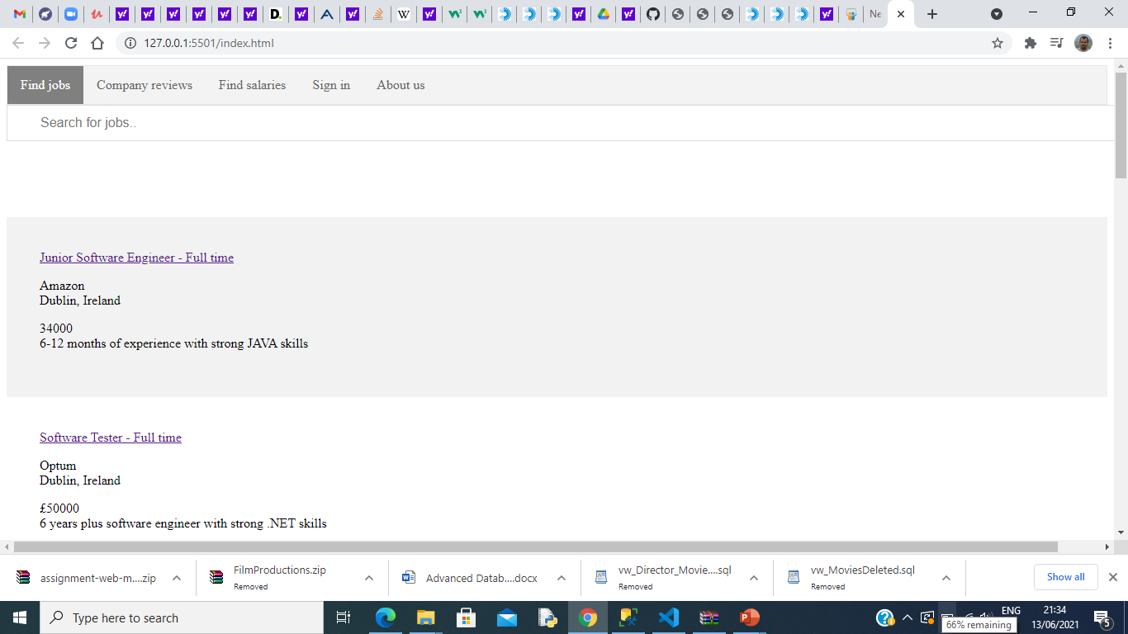
Demo

Slide 6
thanks
TEAM MEMBERS
SHIJU CHANDRA
GOKUL SANJEEV

